Slide 1
BlockModel Tokenomics Made Easy
Model Labs
R&D Infrastructure For Web3

Slide 2




Tokenomics Challenges
01
Only experts can read
Even experts can miss
Single-point of failure
While Tokenomics becomes the key to sustainability for many Web 3.0 projects, the design support of it has been unfortunately MISSING.

Slide 3


BlockModel: Paradigm For Tokenomics
02
Tokenomics Design Framework
Graphical workspace backed by the TMI language, i.e., Tokenomics Modeling Language (ACM MODELS ‘22);
Compatibility with IDEs and Development SDKs.
Version 1
Algorithmic Economy Analysis
Driven by economic properties
Formal Verification
Expert Community
Model DAO to collaboratively design, optimize and validate
Contribute to earn
Version N

Slide 4

BlockModel: Programming Model in DAO
03
E.g., There always exists a market of token T in X days where deposits are more than withdraws.
Property
Model DAO
Proposal & Vote
new properties
model optimization
proof confirmation
...
Protocol
e.g., DeFi, GameFi, Stablecoin etc.
Runtime
Interpreter
Verifier
Model
Proof
E.g., The tokenomics design model X for the DeFi protocol Y is compliant with the set of economic properties Z.
membership
mint

Slide 5
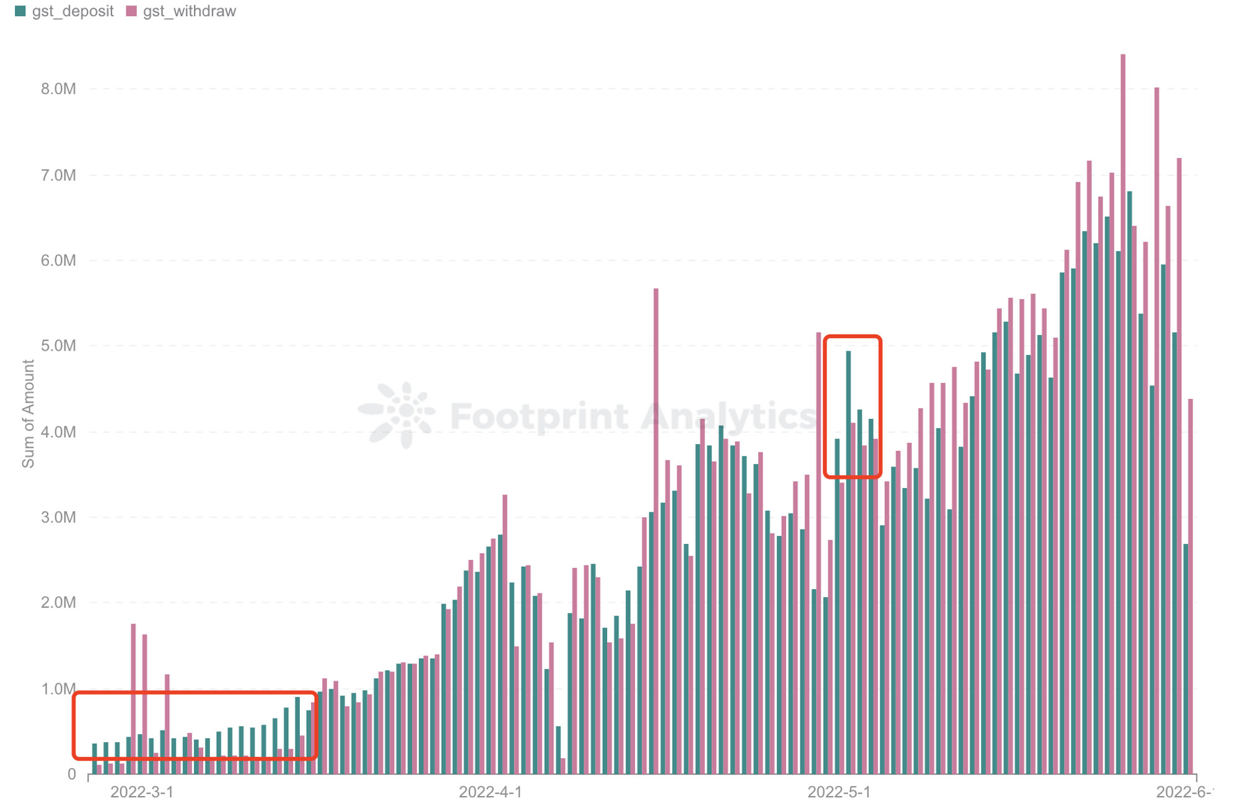

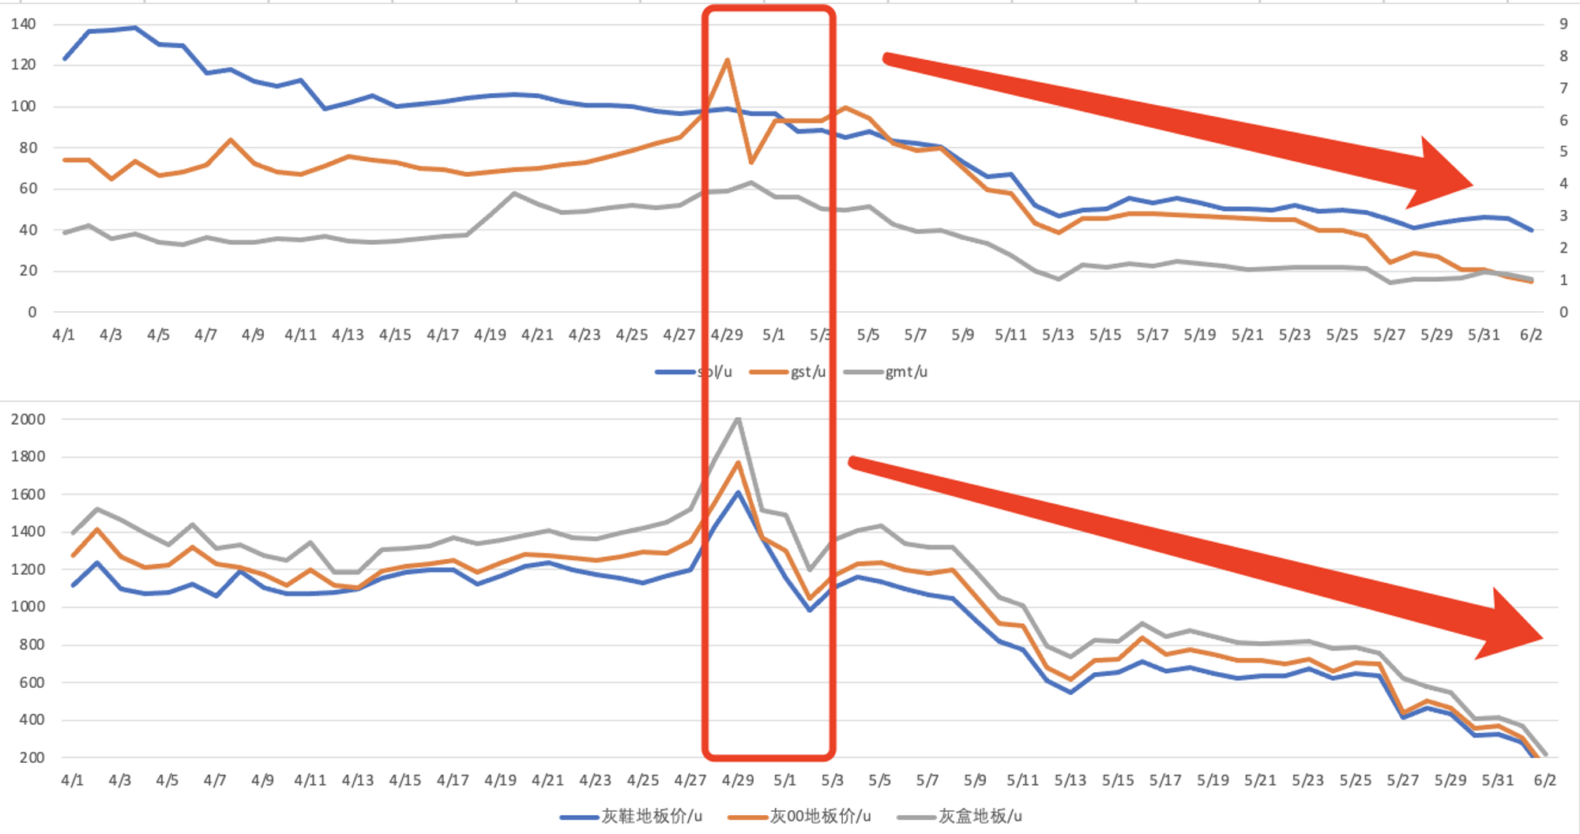
Case Study: StepN
04
GST

Slide 6
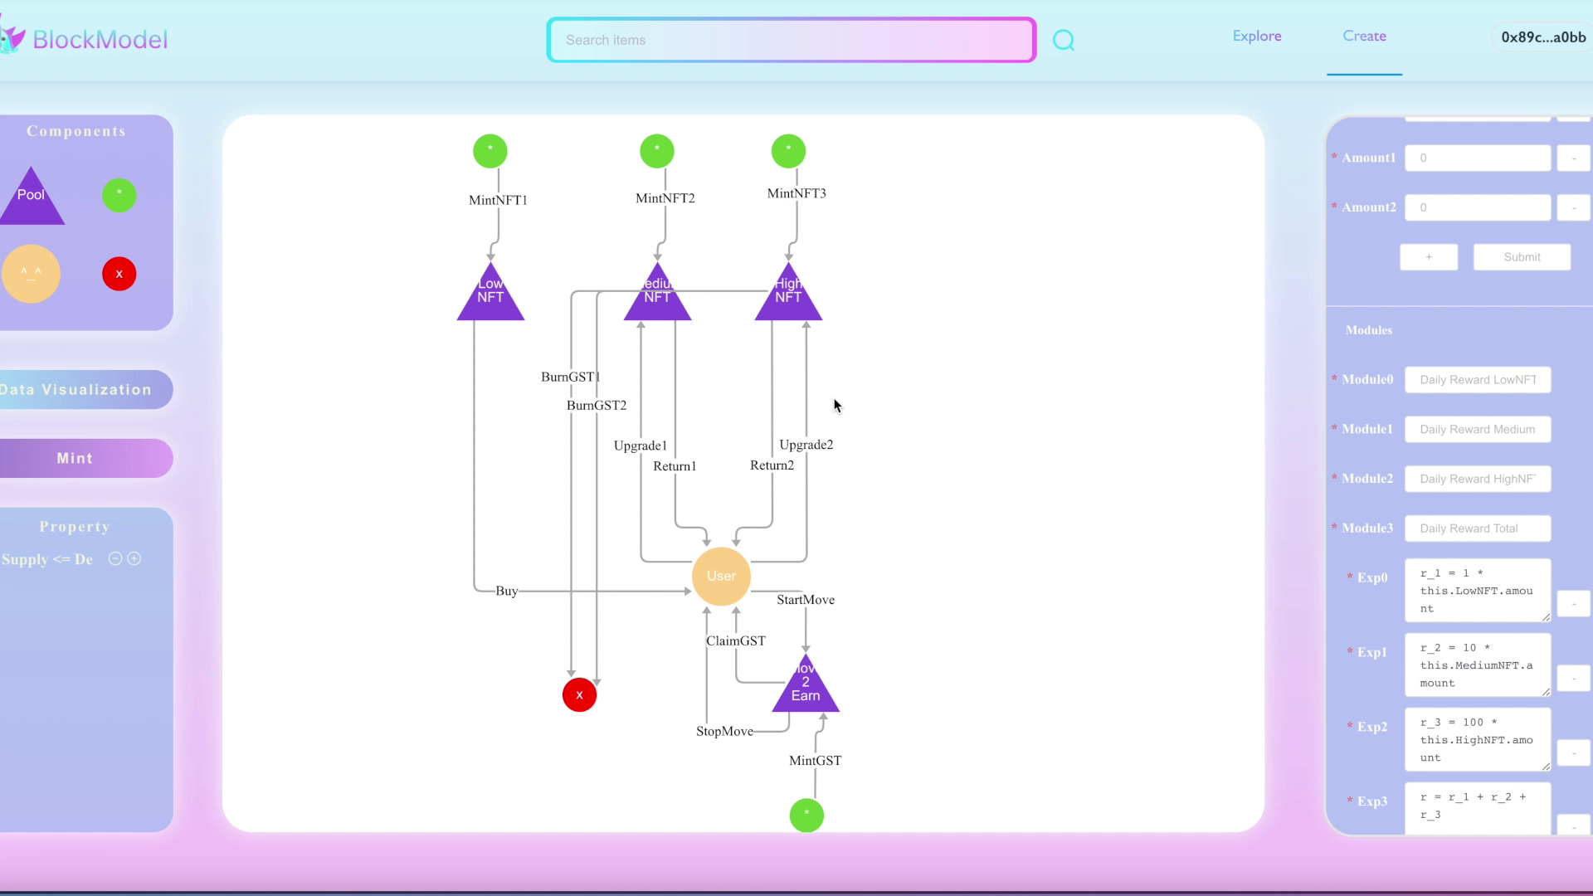
Case Study: StepN
05

Slide 7

Thank You
Website: modellabs.github.io
Twitter: @ModelsResearch
WeChat: Model Labs

